Slide 1
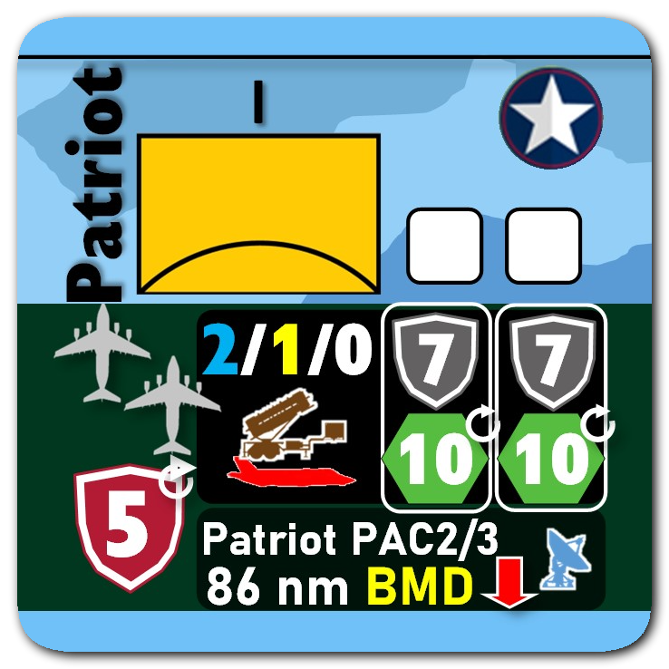
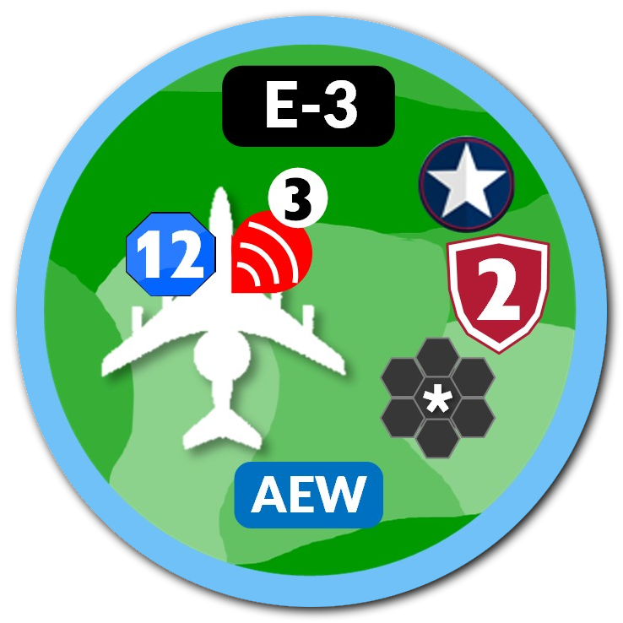
OWS Session #2 - DCA

Slide 2
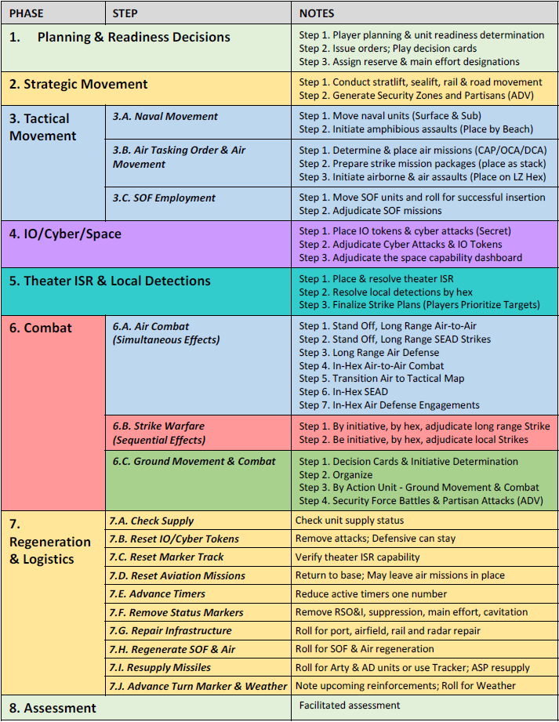
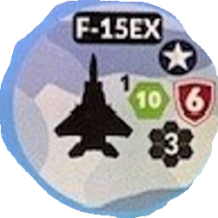
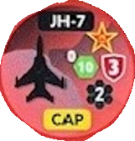
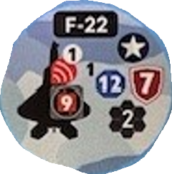
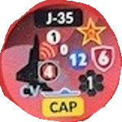
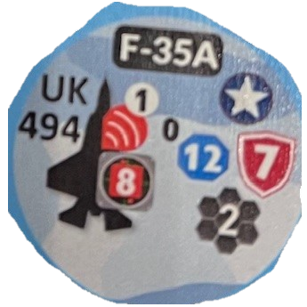
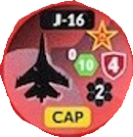
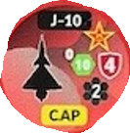
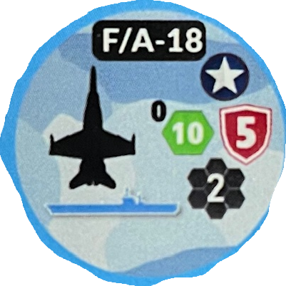
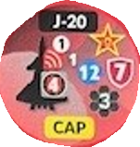
Air-to-air gameplay fundamentals (A2A)
Objectives:
Understand how to conduct the air war sequence in OWS, specifically focusing on:
Determine & Place Air Missions (BLUE DCA v RED OCA)
Resolve Local Detection by Hex
Finalize Strike Plans
Execute Stand-off, Long Range Air-to-Air
Execute In-Hex Air-to-Air Combat
Execute In-Hex Air Defense Engagements
Notes for execution:
All Hexes are 200nm Hexes.
Red places units IAW with Map provided.
Blue places units to best accomplish mission

Slide 3
Air defense units
2.2.7.4. Air Defense Units. Air defense units have organic radar that enables detection of air units out to the range of the counter’s missiles. During combat sequences, an air defense unit can apply defensive shields for units within its defensive umbrella. Or, it may engage threat aircraft that are in range. Air defense units may defend or attack each turn against threat aircraft and missile salvos for which it has unexpended salvos. Once it commits to defend or attack, the shield and die are marked expended. These are reset at the end of the turn during the Regeneration Phase, provided munitions are available.
During this tutorial, the Patriot will only conduct attacks on aircraft
The range marker to the far right is the range for operational 200nm hex map.
Grey Shield (9.2 – 9.2.1.2)
Gray shield symbols represent consumable anti-air missiles. An attack against a unit must first defeat any gray shields applied to its defense before engaging the unit’s enduring defense capability (i.e. its red shield). Use this function when defending against stand-off munitions.
The Patriot has an attack value of “10” against air threats denoted by the red aircraft silhouette.
2 columns represents 2 salvos or engagement opportunities per turn.

Slide 4
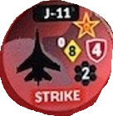
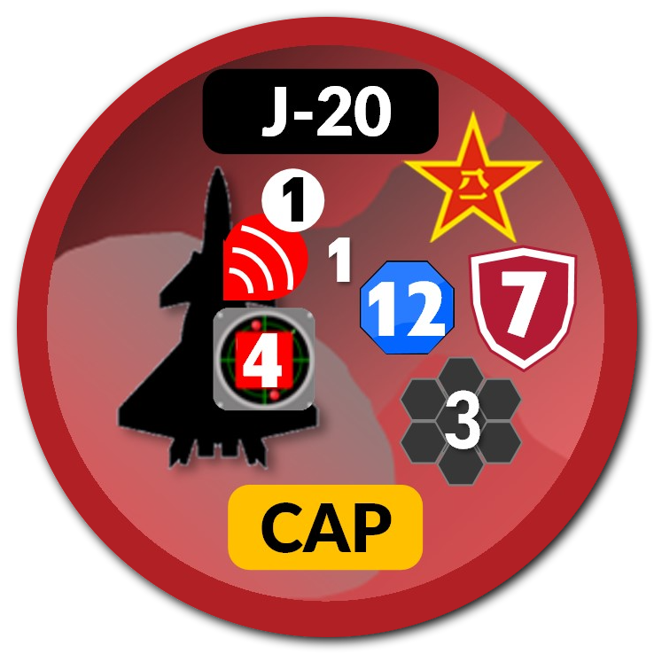
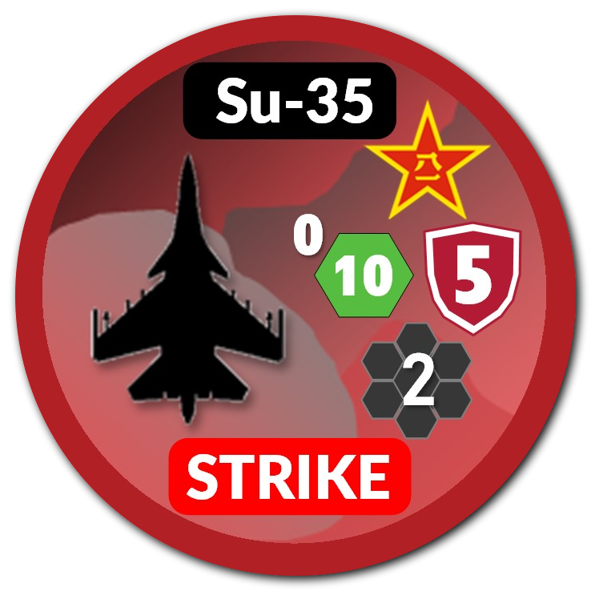

Air-to-air gameplay fundamentals (A2A)
Resolve Local Detections by Hex: Local detection for Air Defense units works the same as A2A detection. In this example, the Patriot rolls a 10-sided die against the unknown red unit. The J-11 and Su-35 (4th gen) are assumed detected.
In-Hex Air Defense Engagements:
Example 1.
The red unknown unit remains undetected. The Patriot can only engage the two strike aircraft. Roll a 10-sided die against each air unit. Declare which unit is being targeting prior to the roll.
Example 2.
The Patriot detected the J-20. It can now choose two of the three air units to engage. The Patriot is still limited to two engagements.
Mark the blank white squares on the Patriot piece with a dry-erase marker after each engagement.
Patriot missiles are reloaded after each game turn.
2.
1.

Slide 5
Air-to-air gameplay fundamentals (A2A)
In-Hex Air Defense Engagements:
Example 3.
1 CAP / OCA and 1 STRIKE aircraft remain. Intended target is the Patriot Battery.
The Patriot has options
Both attack salvos dedicated to one group: ‘10’ attack value rolled twice against same target.
One salvo at each group: ‘10’ attack value each
NOTE!! A double engagement must be declared prior to the engagement.
This means that if the first salvo is effective, the second salvo cannot be reallocated.
3.

Slide 6
Air-to-air gameplay fundamentals (A2A)
AEW Detection will only occur once per 5th gen unit. The detection attempt will occur at the 5th gen unit’s final destination or its first point of contact/contest.
ENHANCED DETECTION (6.5.9)
Example 1. The E-3 AWACS rolls a 6-side die to attempt detection of the J-20. Needs to roll a “4” or higher for detection.
If detected, flip the red unit from unknown to its primary side.
AEW attempts detection of all airborne 5th gen within range.
ENHANCED LETHALITY (6.5.9.1)
AEW promotes all friendly attack values within the AEW’s sensor range.
Example 2: The F-15EX promotes its attack value to ‘12’ if conducting In-Hex Combat against the J-10.
This DOES NOT increase blue fighter detection capability.
Note: At this time, ACSC will NOT apply the optional “best die” rule. 9.7.2 for reference. This rule may be used in later iterations.
1.
2.

Slide 7
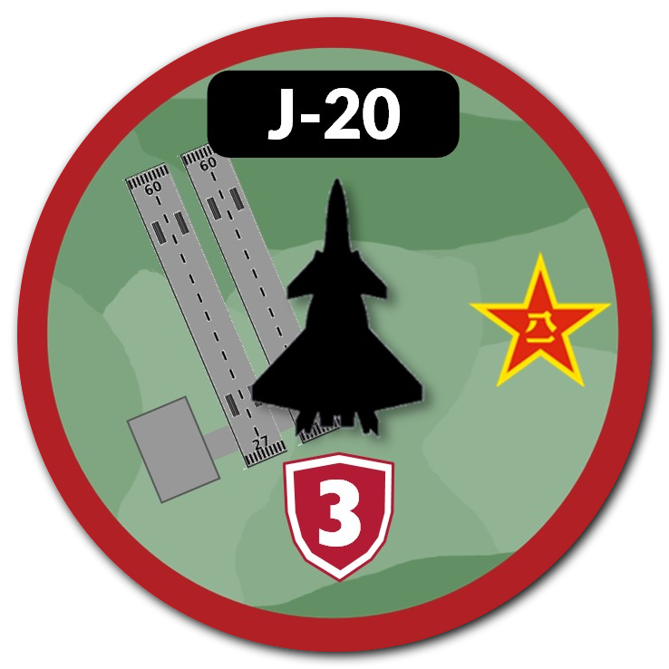

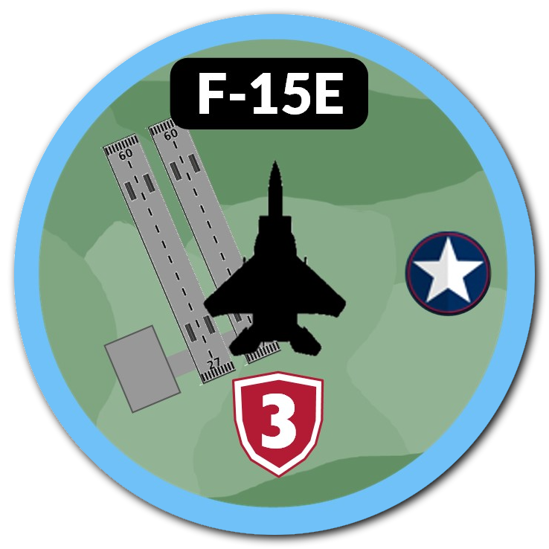
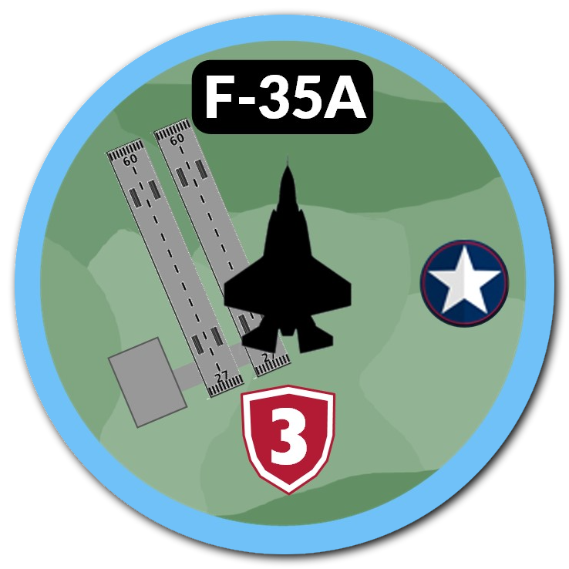
Air-to-air gameplay fundamentals (A2A)
AEW Detection will only occur once per 5th gen unit. The detection attempt will occur at the 5th gen unit’s final destination or its first point of contact/contest.
Determine and place air missions:
Red commits 1x J-20 for OCA-HVAA attack; 1x J-20 for DCA.
Blue commits both fighters to DCA-CAP to hexes north of their airfield.
Resolve Local Detection by Hex
Example 1. How many sensors available?
Both the E-3 AWACS and the F-15EX attempt detection.
E-3 Rolls an ‘8’, F-15EX Rolls ‘10’
F-35 also has a long-range detection if desired, but would then be detected.
Example 2.
Single or multi-detection attempt of remaining J-20?
F-35A stay EMCON?
E-3 AWACS rolls a 6-sided die. Assess.
F-35A may elect to roll a 12-sided die for detection, but flips from Unknown to Known.
5th Gen can execute long-range air-to-air engagements and remain undetected if adversary 5th Gen detected by AEW.
1.
2.
8
What happens if OCA J-20 is undetected?
What happens if J-20 is detected, defeats F-15EX in-hex, and survives?

Slide 8
DCA Gameplay – Alternate initiative
Blue Objectives
Defend ZULU Base from Red Localized Strikes (In-Hex)
Defend the E-3 AWACS (AEW)
Blue will place units on the map and execute as required to meet objectives.
Red Objectives
Destroy/Degrade ZULU Base
Destroy Blue Air Units
Destroy Blue AEW
Red will place units as depicted on the map for the first 2 iterations. Ingress routes can vary.
Two-Turn Game Play – Execute regeneration sequence and play another round with remaining units.
No reinforcements this session.

Slide 9
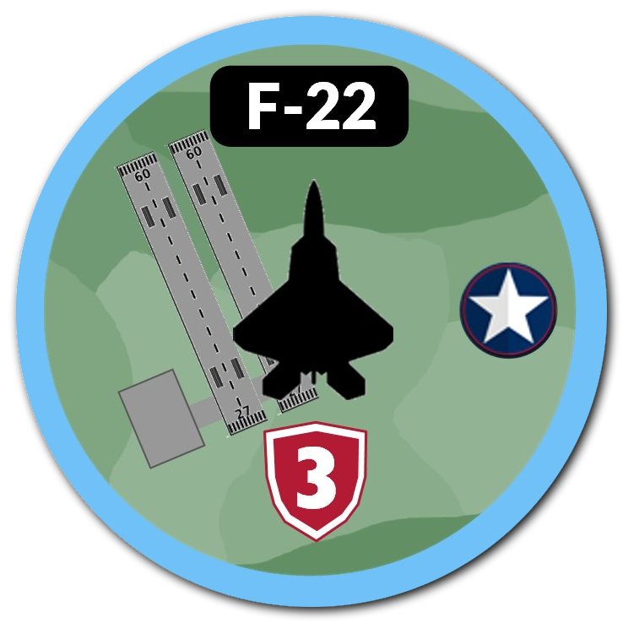
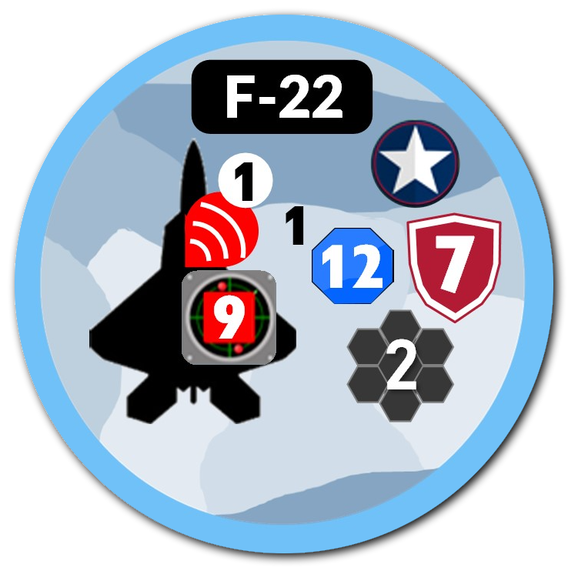
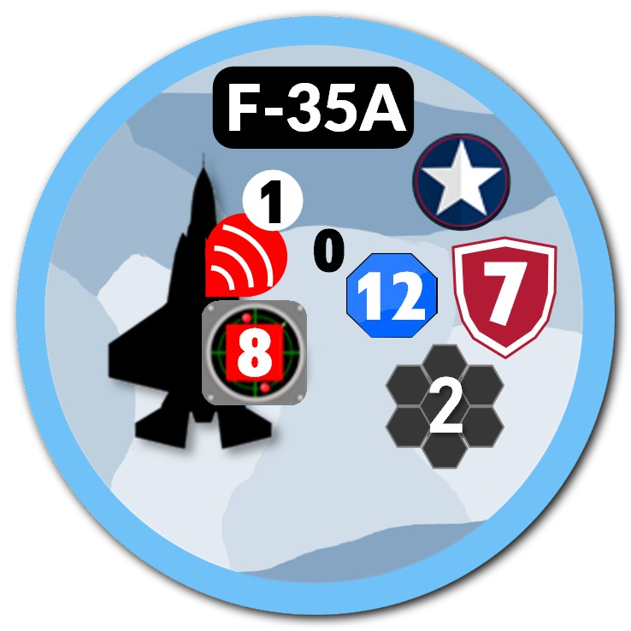
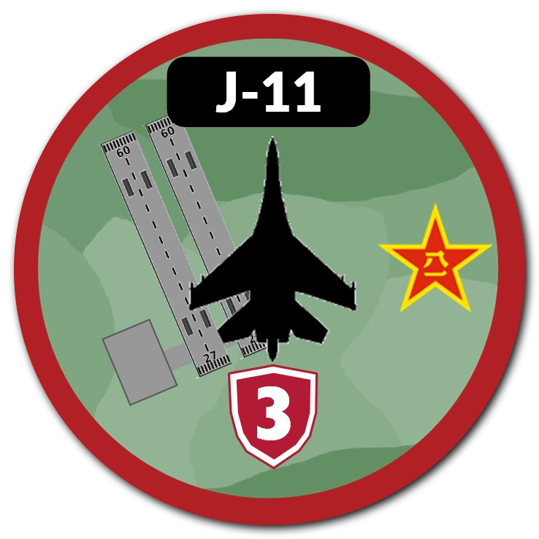
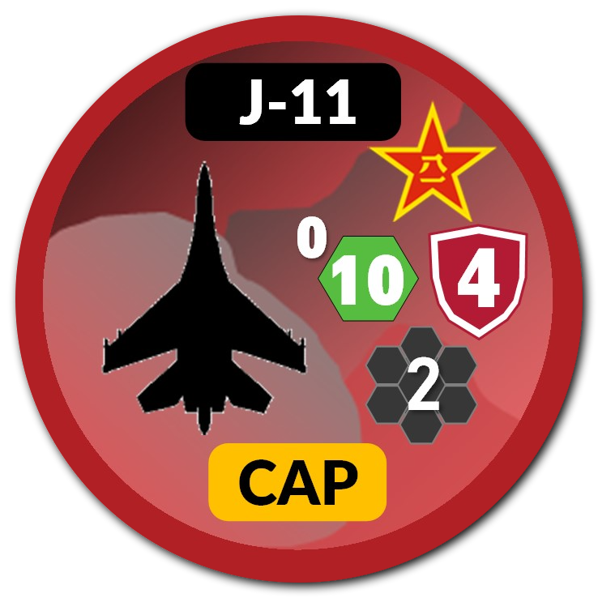
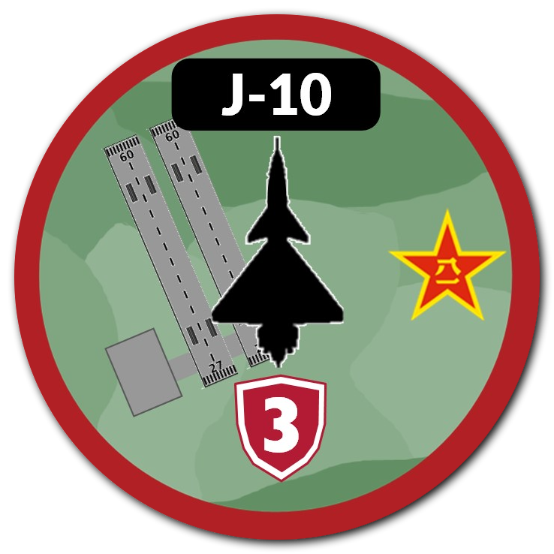
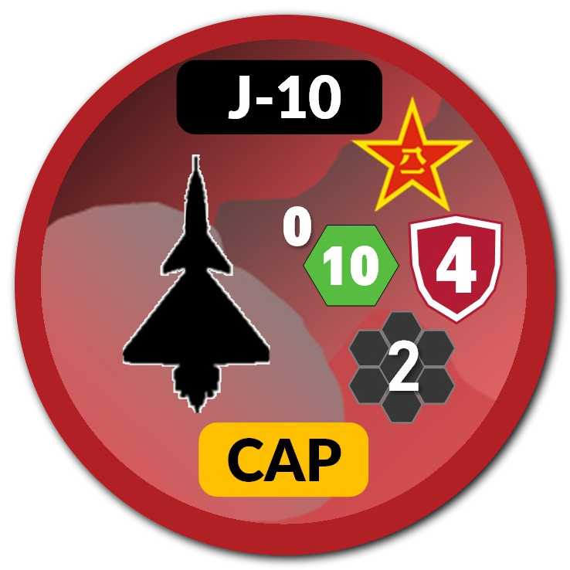
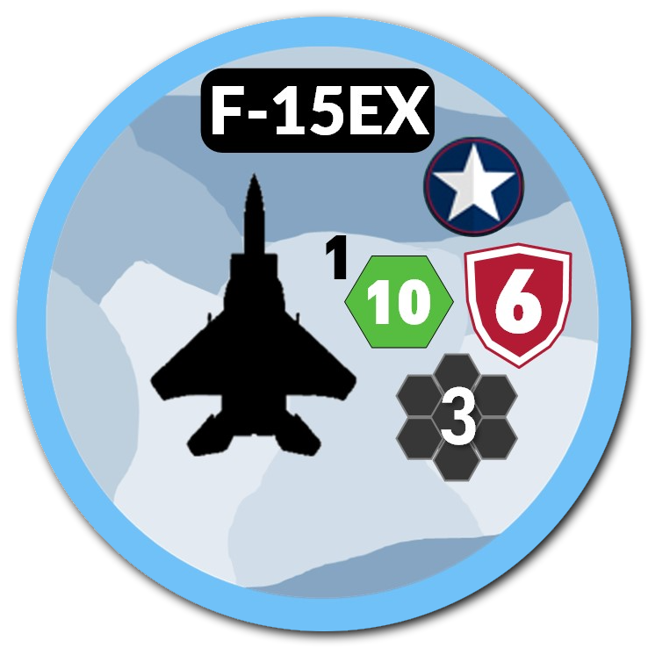
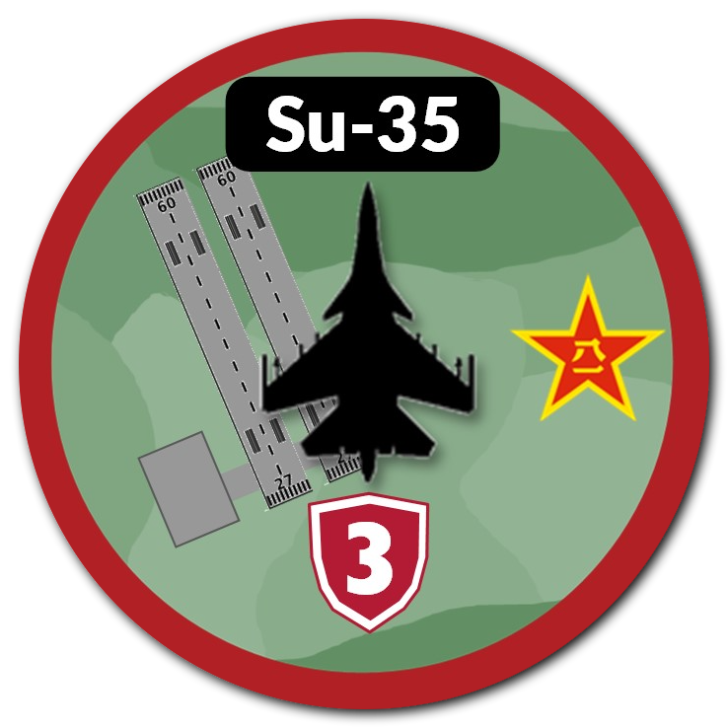
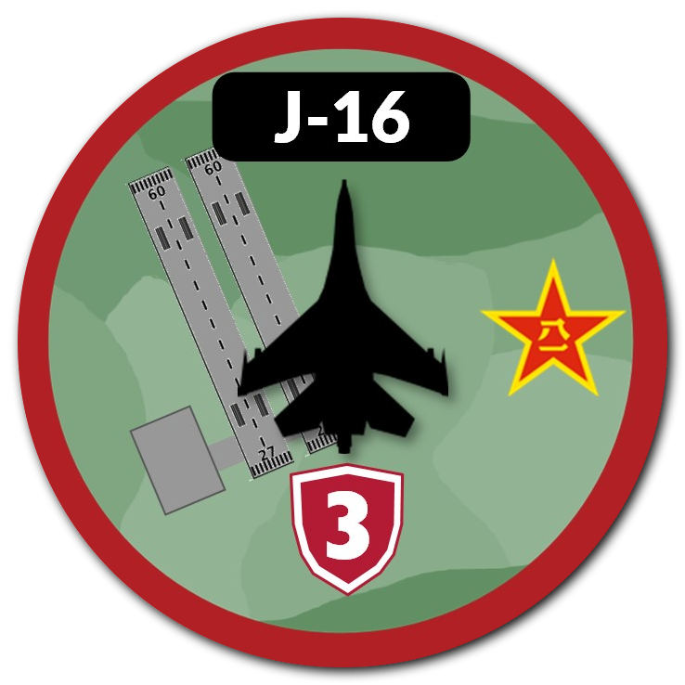
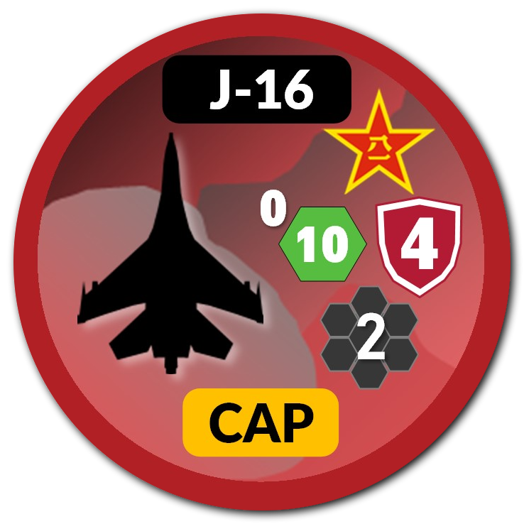
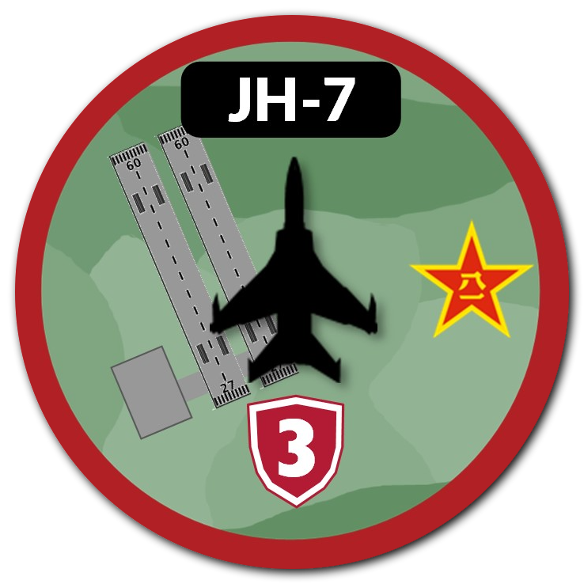
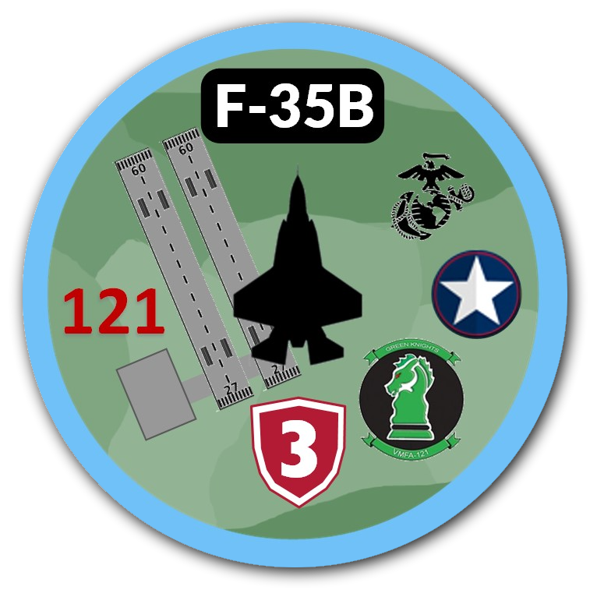
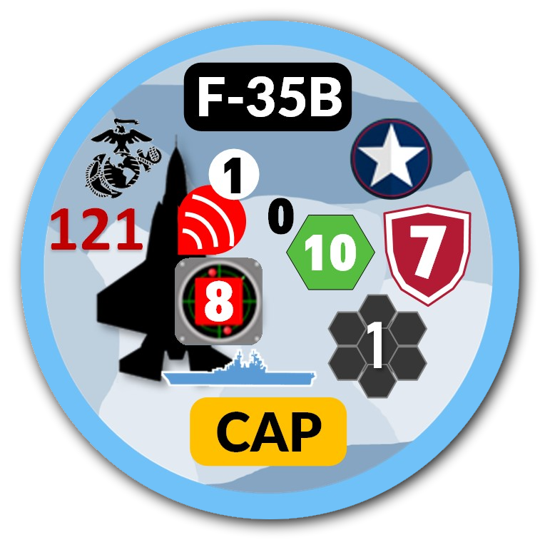
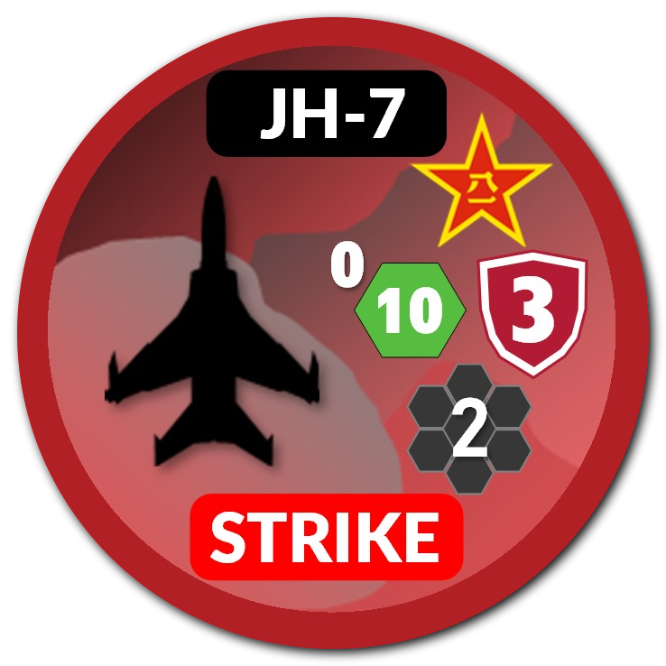
Blue DCA - Obj: Defend HVAA and Zulu Base
Zulu Base (B2) – 3 Fighter Units Limit
Yankee Base (A2) – 3 Fighter Unit Limit
E-3 - No Placement Restrictions
Patriot Battery @ Zulu Base (B2)
RED – Obj:
Destroy/Degrade ZULU BASE
Destroy AEW
Choose between CAP and STRIKE.
D1
D2
D3
D4
D5
8
8
C1
C2
C3
C4
C5
B1
YANKEE BASE
Max 3 Air Units
B2
ZULU BASE
Max 3 Air Units
B3
B4
B5
1 Additional F-35B unit squadron available after 2-3 iterations.
2 Additional units available for use after 2-3 iterations: 1 @ C4; 1 @ A4
A1
A2
A3
A4
A5
9
8

